Slide 1
Introduction to Machine Learning using Azure Notebooks
Speakers -
Vignesh Iyer & Afroz Chakure

Slide 2
What will you learn today?
1
What is Machine Learning ?
ML types ?
2
Discussion on some ML Algorithms
3
Applications of ML
4
5
Implementation in Azure Notebooks

Slide 3
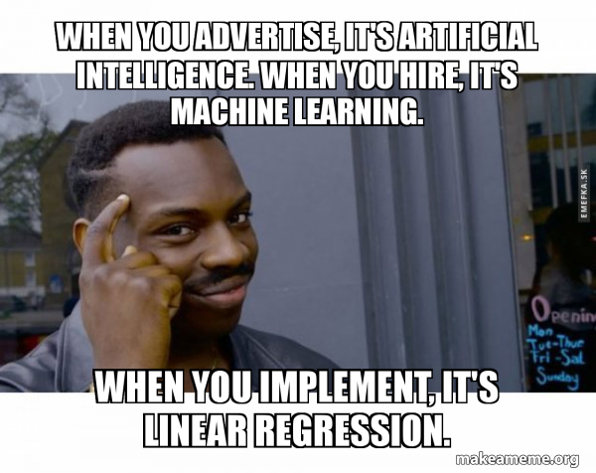
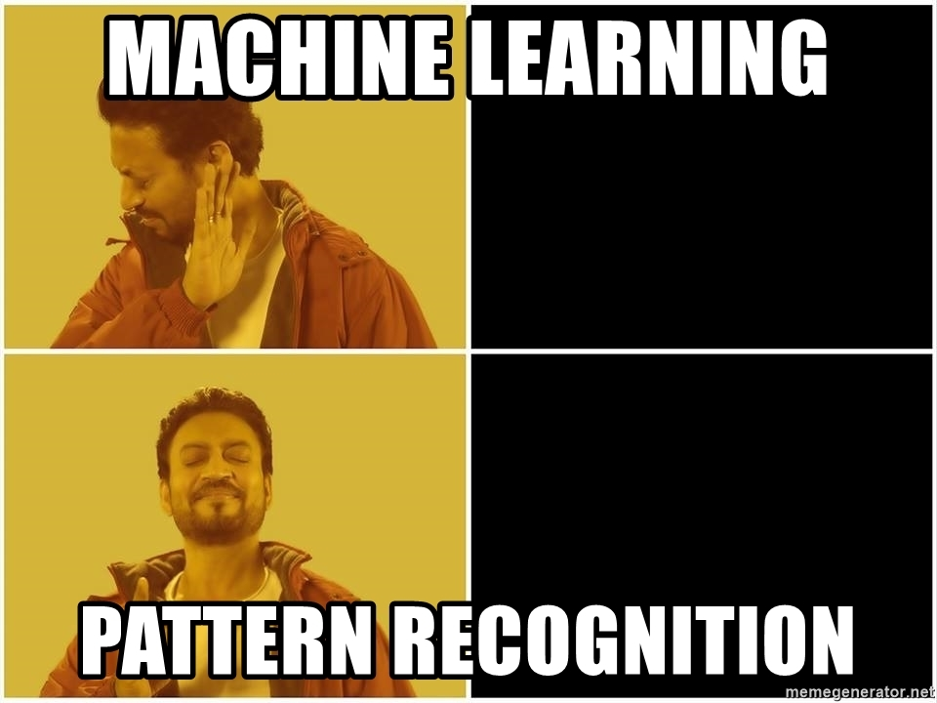
What is Machine Learning? 🤔

Slide 4
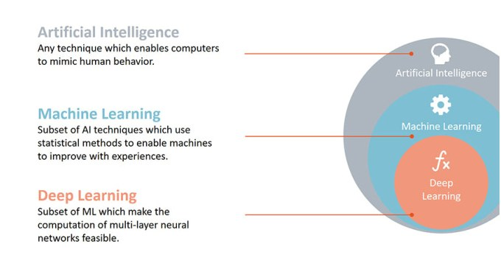
Machine Learning is a subset of Artificial Intelligence

Slide 5
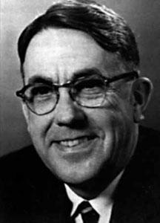
Definition of ML
It is a subfield of Artificial Intelligence and its goal is to enable computers to learn on their own.
“Its gives computers the ability to learn without being explicitly programmed” -
Arthur Samuel (1959), an American pioneer in the field of computer gaming and artificial intelligence

Slide 6
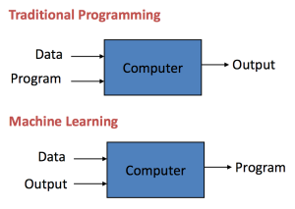
Traditional Programming v/s Machine Learning
In Traditional Programming, we provide Program and Data to our computer to get the Output.
In Machine Learning we feed both Data (input features) as well as the Output (output labels) to our problem and we get the ML model as the result.

Slide 7
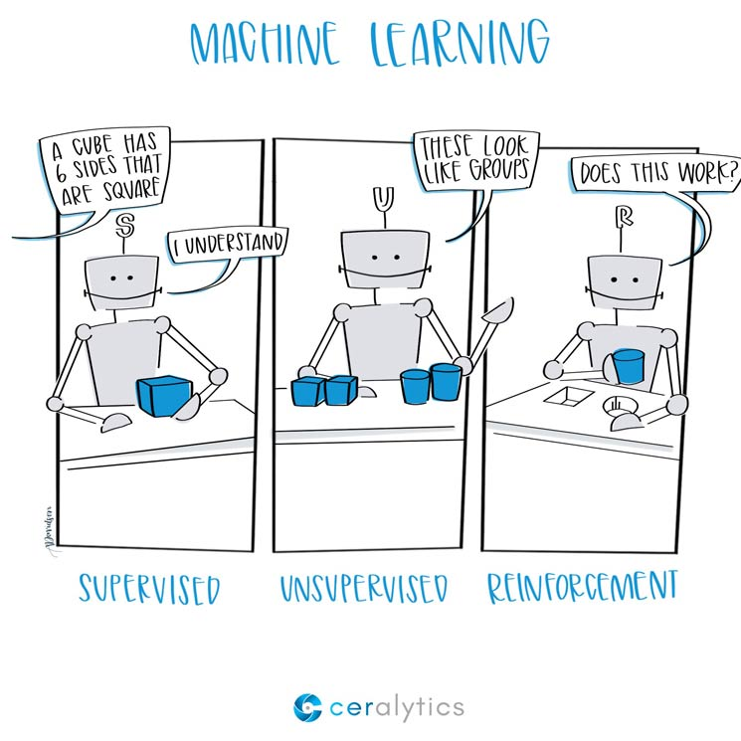
Different Types of Machine Learning
Supervised Learning
Unsupervised Learning
Reinforcement Learning

Slide 8
Supervised Learning
In supervised learning, we are given a data set and we already know what our correct output should look like, having the idea that there is a relationship between the input and output.
Problem type: Given A find B.
Based on desired output, Supervised Learning can further be divided into:
Regression - Estimate Continuous values (Real valued output)
Classification - Identify a unique class (Discrete values, Boolean or Categories)

Slide 9
Regression and Classification
1.1 Regression:
A regression model predicts value (dependent variable) based on independent variables. Used for finding out the relationship between variables and forecasting.
It can be used to predict a real valued output. For example, Predict the age of a person, given the picture of the person.
1.2 Classification:
A classification model groups the output into a class. If what we are trying to predict is discrete or categorical then it is a classification problem.
For example, if you want to determine whether a stock is “overvalued” or “undervalued” i.e. Classifying a stock into 2 discrete categories.
Notes:
Here age is a real valued output

Slide 10
Supervised Learning Algorithms
Regression Algorithms:
Linear Regression
Support Vector Regression (SVR)
Decision Tree Regression, Random Forest Regression, etc.
Classification Algorithms:
Logistic Regression
K-Nearest Neighbors
Support Vector Machines (SVMs), Decision Tree Classification, Random Forest Classification, etc

Slide 11
2. Unsupervised Learning
2. Unsupervised Learning:
In Unsupervised Learning we have little or no idea about what our results look like.
We can derive structure from data where we don’t necessarily know the effect of the variables.
This can be derived by clustering the data based on the relationships among the variables.
Method to solve Unsupervised Learning problems:
2.1 Clustering: It is the task of grouping a set of objects in such a way that objects in the same group (called a cluster) are more similar (in some sense) to each other than to those in other groups (clusters).

Slide 12
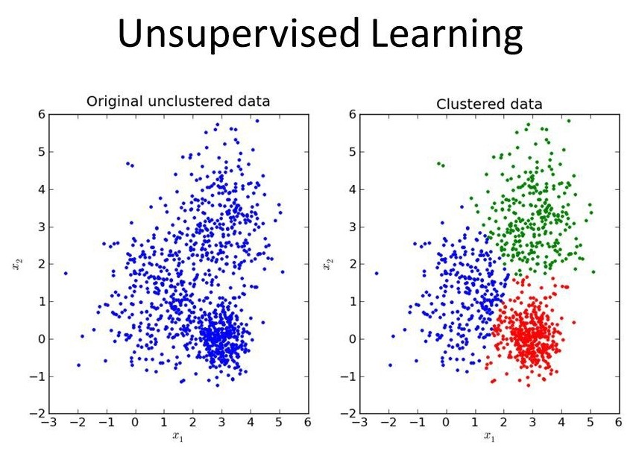
2.1 Clustering Algorithm

Slide 13
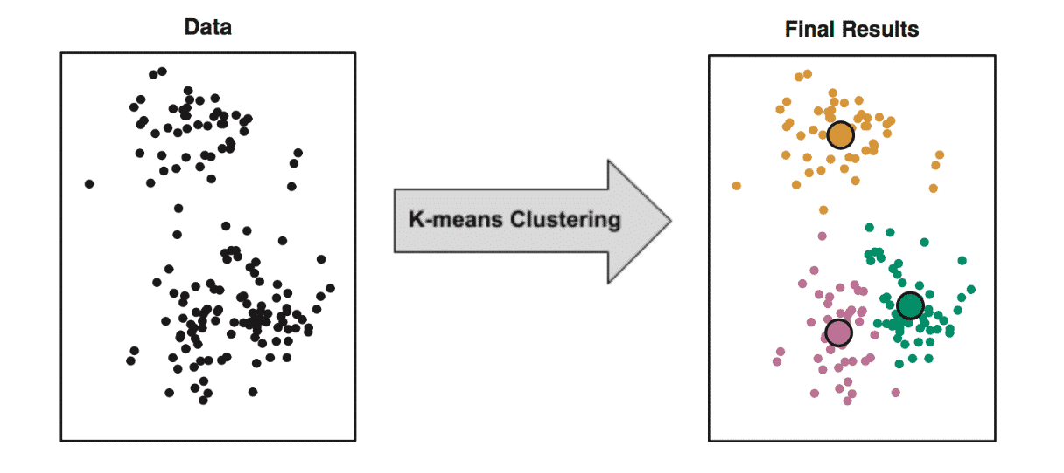
Unsupervised Learning Algorithms
K-Means Clustering
Hierarchical Clustering
Apriori Algorithms
FP Tree

Slide 14
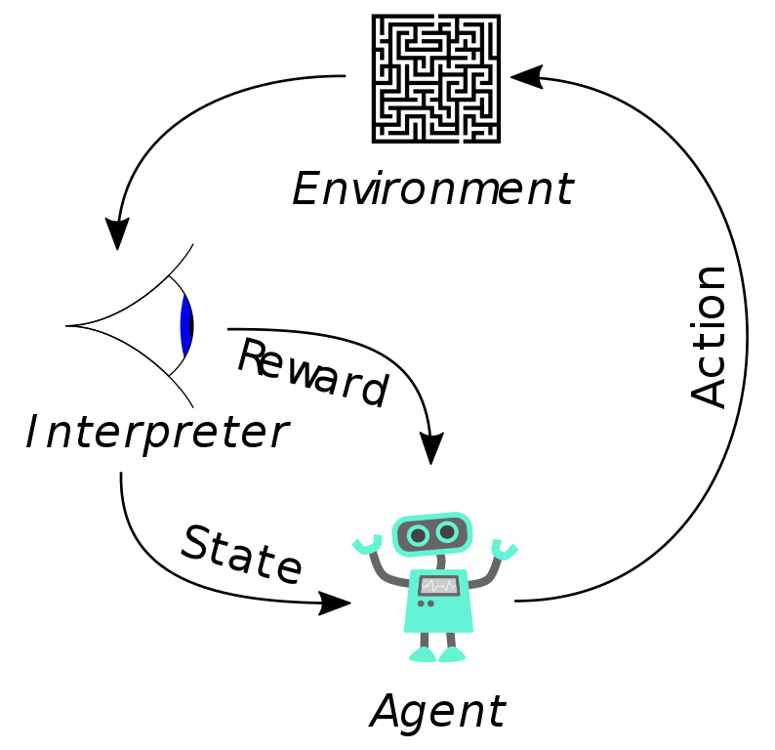
3. Reinforcement Learning
It is about taking suitable actions to maximize reward in a particular situation. It is employed by various software and machines to find the best possible behavior or path to take in a specific situation.
Unlike Supervised Learning where the training data has the answer key with it, in RL there is no answer. In the absence of any training dataset, it learns from experience.
The R.L. agent determines what to do, to perform the given task.
Examples:
Business strategy planning.
Robotics for Industrial Automation.
Games like Chess, Go, checkers etc.
Self Driving Cars.

Slide 15

Some Applications of ML
Virtual Personal Assistants. (Alexa, Google Home, Microsoft Cortana, etc)
Predictions while commuting, Videos Surveillance, Social Media Services.
Email Spam and Malware Filtering.
Game AI (eg: Generating sound effects on the fly, Customized game experience, etc)
Online Customer Support.
Search Engine Result Refining.
Product Recommendations.
Online Fraud Detection.

Slide 16
Linear Regression (Supervised Learning)
In Supervised Learning, the goal is given a training set, to learn a function h: X -> Y such that h(x) is a “good predictor” for the corresponding value of y.
h is called the hypothesis function.
A Linear Regression model attempts to explain the relationship between one or more variables using a straight line.
Training Set
Learning Algorithm
Input size of house (X)
Output estimated price (Estimated value of Y)
h

Slide 17
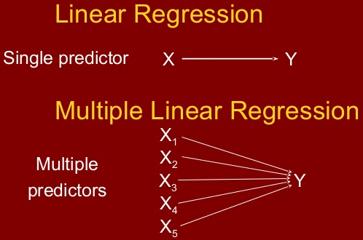
General Equation for Linear Regression
Multiple Linear Regression :
y = b₀ + (b₁ * x₁)+ (b₂ * x₂) + ……..+ (b_{n} * x_{n}) + ε
Terms:
y - Dependent Variable (Labels)
b₀ - Constant/ Intercept (Prediction value when x1, x2, x3, …, and xn = 0)
b₁, b₂, b₃, ….b_{n} - Coefficients
x₁, x₂, x₃, ….x_{n} - Independent Variables (Features)
ε - Error (It’s Residual value i.e. Difference b/w actual and predicted value)

Slide 18
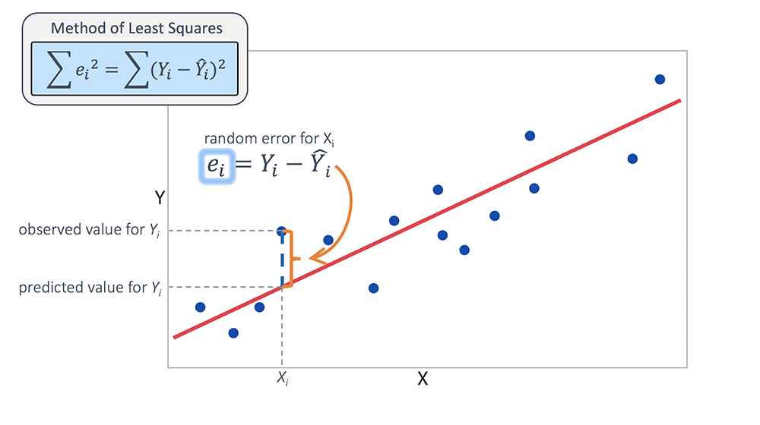
Objective of Linear Regression
The objective of Linear Regression is to get the Best Fit line (It best represents the points on the line).
The best possible line will be such that the average squared vertical distances of the scattered points from the line will be the least.
Least Squares Method:
Reduce the sum of squared errors
∑(Actual(y) - Predicted(y'))²
by finding the best possible value of regression coefficients (b₀, b₁, etc).

Slide 19
Decision Tree
It builds classification or regression models in the form of a tree structure.
It breaks down a dataset into smaller and smaller subsets while at the same time an associated Decision Tree is incrementally developed.
Decision Tree consists of:
Nodes : Tests for the value of a certain attribute.
Edges/ Branch : Corresponds to the outcome of a test and connect to the next node or leaf.
Leaf nodes : Terminal nodes that predict the outcome (Represents class labels or class distribution).

Slide 20
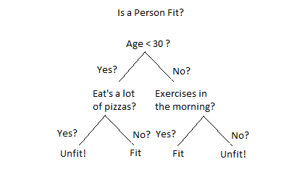
Decision Tree Classification Example
Deciding if the person is “Fit” or “Unfit” using Decision Tree.
Node - Test value of an attribute.
Edges - Corresponds to the outcome of a test.
Leaf Nodes - Represents class labels (outcome).

Slide 21
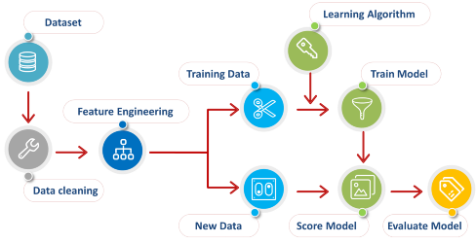
Machine Learning Process

Slide 22


Demo

Slide 23




Connect with us :)
bit.ly/afrozchakure
bit.ly/vigneshiyer
twitter.com/ afrozchakure
twitter.com/vigucodes

Slide 24
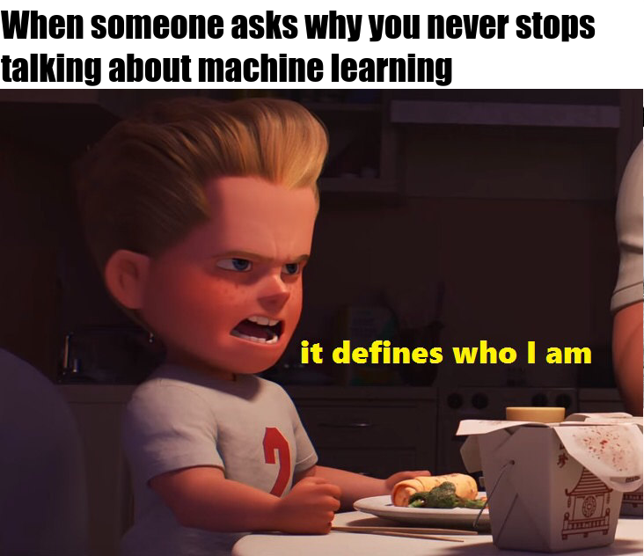
Thank You 😜

